Slide 1

Logistic Regression Week 2
The Mets Stink

Slide 2
Recap
Logistic regression is a statistical method used to model the relationship between a binary dependent variable (outcome) and one or more independent variables (predictors) by estimating the probability of the dependent variable being in a particular category.
Unlike linear regression, which predicts continuous outcomes, logistic regression is specifically designed for binary outcomes (e.g., yes/no, presence/absence, success/failure).

Slide 3
Recap
Linear Regression fits a Linear line through a set of points while logistic regression fits a Logistic (sinusoidal) curve through the points.
Predicts the probability of belonging to a certain category, not the actual value.

Slide 4
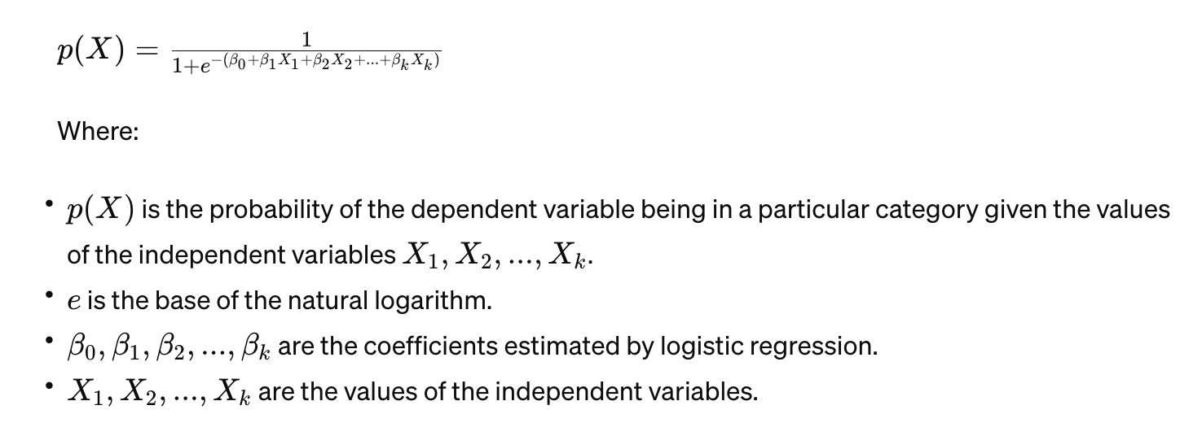
The Logistic Function

Slide 5
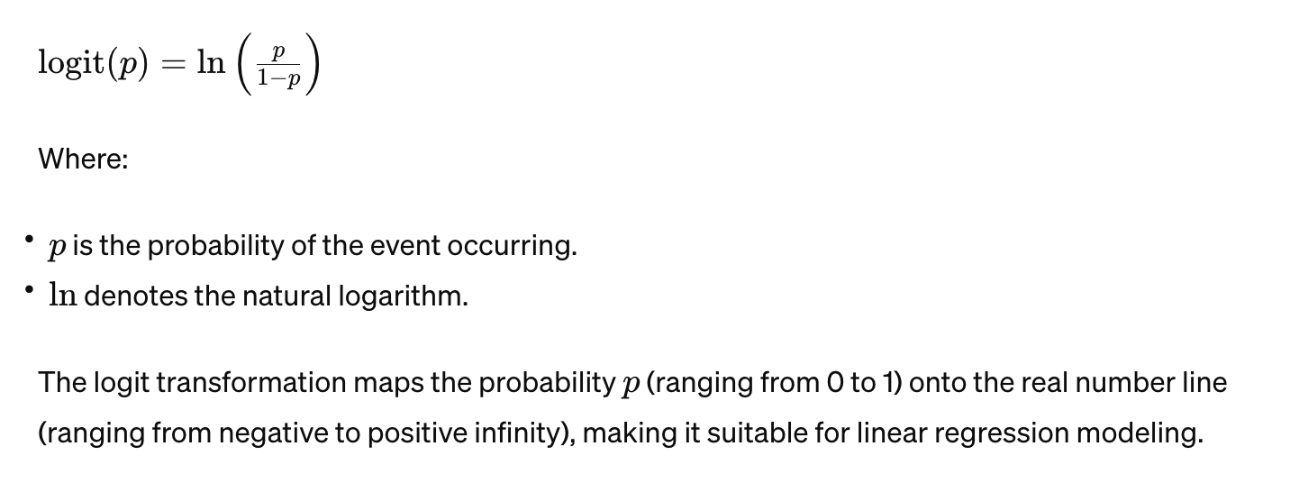
The Logit Transformation (log odds)
Natural Logarithm of the odds ratio (the probability of the event occurring divided by the probability of the event not occurring) and is used to linearize the relationship between the dependent variable and the independent variables in logistic regression.

Slide 6
Odds Ratio Recap
Scenario: Suppose we are studying the relationship between regular exercise and the likelihood of developing heart disease among a group of individuals. We want to determine the odds ratio of developing heart disease for individuals who exercise regularly compared to those who do not.
Data:
In our sample:
100 individuals exercise regularly, out of which 20 have developed heart disease.
50 individuals do not exercise regularly, out of which 15 have developed heart disease.
Calculation of Odds:
Regular Exercise Group:
Number of individuals exercising regularly and developing heart disease = 20
Number of individuals exercising regularly but not developing heart disease = 80
Odds of developing heart disease among those who exercise regularly = 20/80=0.258020​=0.25
No Regular Exercise Group:
Number of individuals not exercising regularly and developing heart disease = 15
Number of individuals not exercising regularly and not developing heart disease = 35
Odds of developing heart disease among those who do not exercise regularly = 15/35=0.42863515​=0.4286

Slide 7
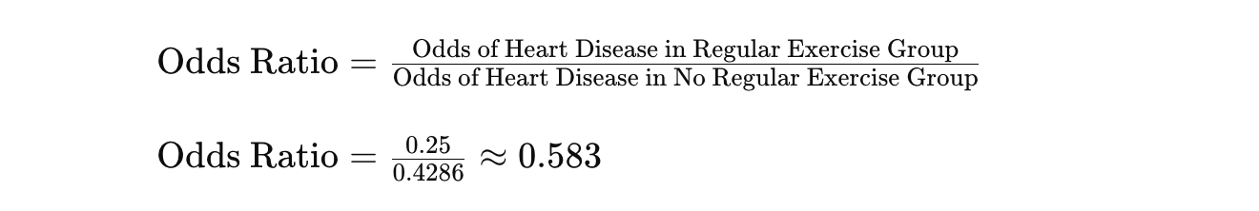
Calculation of Odds Ratio:
The odds ratio is the ratio of the odds of developing heart disease for individuals who exercise regularly to the odds of developing heart disease for individuals who do not exercise regularly.
Interpretation:
An odds ratio of 0.583 indicates that individuals who exercise regularly have approximately 0.583 times the odds of developing heart disease compared to individuals who do not exercise regularly.
In other words, regular exercise is associated with a lower likelihood of developing heart disease, as indicated by an odds ratio less than 1.

Slide 8
Back to Logistic Regression
Binary Dependent Variable: Logistic regression requires the dependent variable to be binary or dichotomous.
Independence of Observations: Observations in the dataset should be independent of each other.
Linearity of Independent Variables and Log Odds: The relationship between the independent variables and the log odds of the dependent variable should be linear.
No Multicollinearity: The independent variables should not be highly correlated with each other.
Large Sample Size: Logistic regression performs well with a large sample size to ensure stable parameter estimates and accurate predictions.

Slide 9
The Model Produces….A Probability of belonging to a class!
The predicted probabilities range from 0 to 1, where values closer to 1 indicate a higher likelihood of the event occurring. These probabilities can then be used to make binary predictions by applying a threshold value (e.g., 0.5), above which the outcome is predicted as belonging to the positive category, and below which it is predicted as belonging to the negative category.

Slide 10
How Do We Choose That Threshold Value?
The Great Sensitivity vs. Specificity Tradeoff

Slide 11
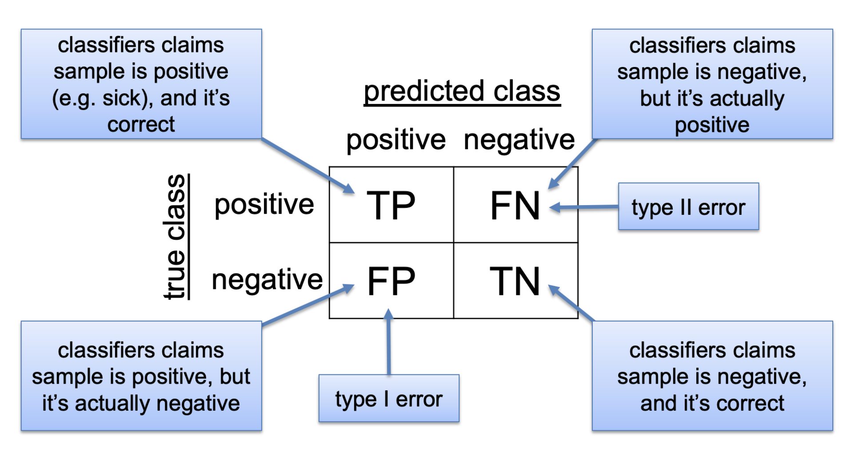
Recap
True Positive (TP): Instances where the model correctly predicts the positive class.
True Negative (TN): Instances where the model correctly predicts the negative class.
False Positive (FP): Instances where the model incorrectly predicts the positive class (Type I error).
False Negative (FN): Instances where the model incorrectly predicts the negative class (Type II error).

Slide 12

Specificity
The ability of a diagnostic test to correctly identify true negatives.
In the context of logistic regression and classification tasks, specificity measures the proportion of actual negative cases that the model correctly predicts as negative.
A high specificity indicates that the model has a low rate of false positives, meaning it accurately identifies individuals who do not belong to the positive class.
This is Rudolph. He doesn’t really have covid. He has sniffles though. His parents desperately want him to go to school, but they also don’t want to be THOSE parents who get the rest of the class sick.
Therefore, the last thing they want is a FALSE POSITIVE.
They opt for a test with high Specificity.

Slide 13
Specificity
“true negative rate”
TN\N = TN\TN+FP

Slide 14

Sensitivity (Recall)
The ability of a diagnostic test to correctly identify true positives.
In logistic regression, sensitivity represents the proportion of actual positive cases that the model correctly predicts as positive.
A high sensitivity indicates that the model has a low rate of false negatives, meaning it accurately identifies individuals who belong to the positive class.
This is a new rate, super deadly and contagious virus. Only a very few people have the disease so far. We must find those 4 people and quarantine them. We are willing to sacrifice some false positives and make some folks quarantine who don’t have to.
Therefore, the last thing we want is a FALSE NEGATIVE. The virus gets away and we all have to go back to zoom classes!!
We opt for a test with high Sensitivity.

Slide 15
Sensitivity
Fraction of actual positives predicted to be positive.
TP\TP+FN

Slide 16
Precision
Precision measures the proportion of true positive cases out of all instances that are predicted as positive by the classification model.
It calculates the accuracy of the model's positive predictions, indicating how confident we can be that a positive prediction is indeed correct.
Precision is calculated as TP\TP + FP

Slide 17
Example
Scenario: Email Spam Detection
Imagine you are developing a spam detection system for an email service provider. The goal is to classify incoming emails as either spam or non-spam (ham).
Sensitivity (Recall): Sensitivity, also known as recall, measures the ability of the model to correctly identify spam emails out of all actual spam emails in the dataset.
Suppose your spam detection model correctly identifies 90 out of 100 spam emails in the dataset (true positives) but misses 10 spam emails (false negatives).
Sensitivity = TP\TP+FN = 90\90+10 = 0.90
Interpretation: The sensitivity of your spam detection model is 0.9, indicating that it correctly identifies 90% of all actual spam emails.

Slide 18
Continued.
Precision: Precision measures the accuracy of the model's positive predictions, i.e., the proportion of correctly identified spam emails out of all emails predicted as spam by the model.
Suppose your spam detection model correctly identifies 90 spam emails (true positives) but incorrectly labels 30 non-spam emails as spam (false positives).
Precision = TP\TP+FP = 90\90+30 = 0.75
Interpretation: The precision of your spam detection model is 0.75, indicating that out of all emails predicted as spam, 75% are actually spam.

Slide 19
Continued
Specificity measures the ability of the model to correctly identify non-spam (ham) emails out of all actual non-spam emails in the dataset.
Suppose your spam detection model correctly identifies 970 out of 1000 non-spam emails as non-spam (true negatives) but incorrectly labels 30 non-spam emails as spam (false positives).
Specificity = TP\TP+FP = 970\970+30 = 0.97
The specificity of your spam detection model is 0.97, indicating that it correctly identifies 97% of all actual non-spam emails.

Slide 20
In Sum
Sensitivity (Recall) measures the model's ability to detect all actual positive instances (spam emails), minimizing false negatives.
Precision measures the accuracy of the model's positive predictions, minimizing false positives.
Specificity measures the model's ability to detect all actual negative instances (non-spam emails), minimizing false positives.
In the context of email spam detection, high sensitivity ensures that most spam emails are correctly identified and filtered out, while high specificity ensures that most non-spam emails are correctly identified and not mistakenly labeled as spam. Balancing these metrics is essential to designing a robust and effective spam detection system that minimizes both false positives and false negatives.

Slide 21
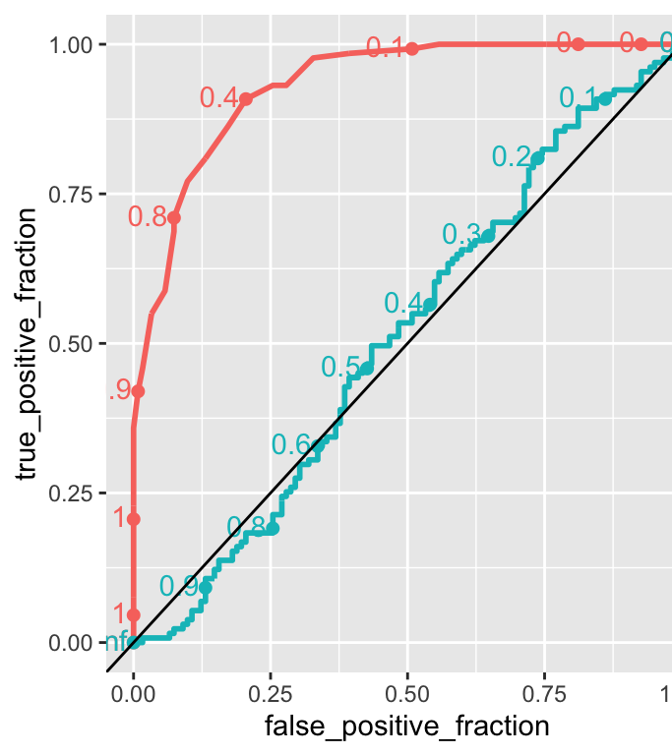
ROC Curve (Receiver Operating Characteristic)
A graphical representation of the trade-off between sensitivity and specificity for different threshold values.
It plots the true positive rate (sensitivity) against the false positive rate (1 - specificity) at various threshold settings.
The area under the ROC curve (AUC) is a commonly used metric to quantify the overall performance of a classification model.
A higher AUC value indicates better discrimination ability of the model across all possible thresholds.

Slide 22
ROC
The points along the lines represent the cutoff value. If all instances are classified as positive (cutoff=0) then the false positive rate is 1 and so is the true positive rate.
On the other hand, if all instances are classified as negative (cutoff=1) then, the false positive rate is 0 and so is the true positive rate.
A random classifier has a ROC curve which always approximates a diagonal, such can be seen in the previous figure as the close to diagonal line, while the other curve is the ROC for the logistic prediction.
https://gagneurlab.github.io/dataviz/chap-log-reg.html#interpreting-a-logistic-regression-fit

Slide 23
Cutoff = 0
When all instances are classified as positive, it means that the model's threshold for determining whether an instance belongs to the positive class is set very low. In other words, the model is very lenient in classifying instances as positive.
Setting the cutoff value to 0 implies that any predicted probability above 0 (or any score above 0, depending on the model) is classified as positive.
At this cutoff value, the model will predict all instances, including both true positives (correctly classified positive instances) and false positives (incorrectly classified negative instances), as positive.
Since all instances are classified as positive, there are no true negatives or false negatives in this scenario.
Consequently, the false positive rate (FPR) and the true positive rate (TPR) are both equal to 1.

Slide 24
Cutoff = 1
Setting the cutoff value to 1 means that only instances with predicted probabilities (or scores) equal to 1 are classified as positive.
At this cutoff value, the model will predict no instances as positive unless their predicted probability (or score) is exactly 1.
Consequently, there are no true positives (correctly classified positive instances) or false positives (incorrectly classified negative instances) in this scenario.
Since no instances are classified as positive, there are also no true negatives (correctly classified negative instances) or false negatives (incorrectly classified positive instances).

Slide 25
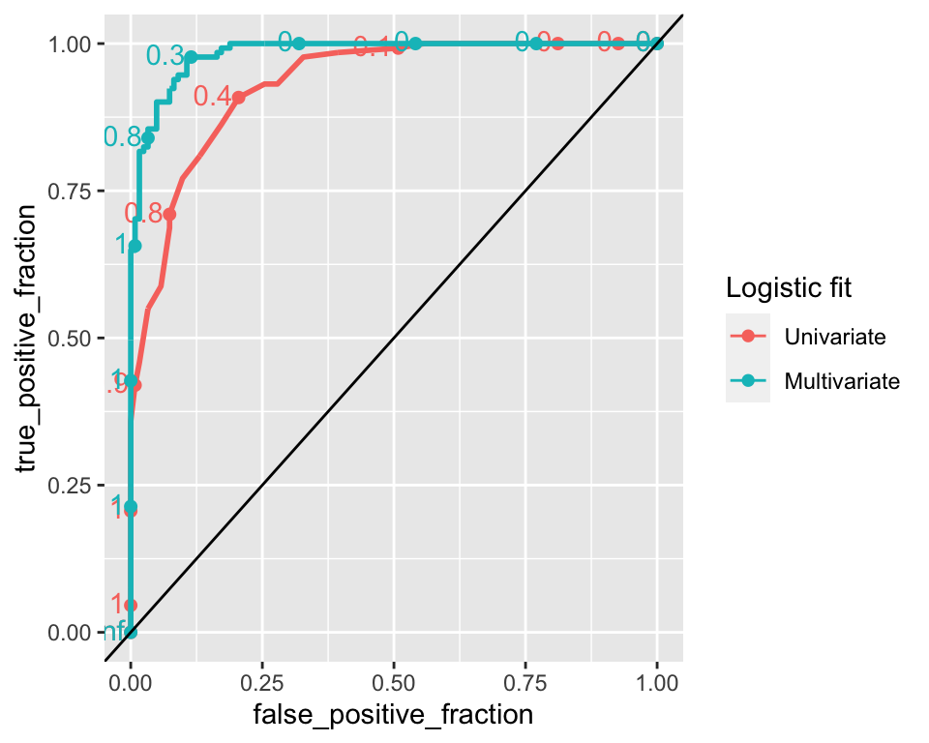
Comparing Models
Classification performance can also be measured by the AUC (area under the ROC curve).
An AUC of 1 means that the model is perfectly able to distinguish between the positive and negative classes.
An AUC of 0.5, which corresponds to the AUC of a ROC curve which is a diagonal line, means the classifier model is no better than random classification.

Slide 26
Scenarios When to Prioritize Sensitivity or Specificity
Environmental Hazard Detection:
Scenario: Imagine a city facing the challenge of identifying areas at risk of soil contamination due to industrial activities.
Specificity Over Sensitivity:
Favoring specificity would mean minimizing false positive predictions, i.e., accurately identifying areas without soil contamination as safe.
In this case, false alarms (false positives) could lead to unnecessary regulatory actions, economic burdens on property owners, and public concern over false environmental risks.
Prioritizing specificity ensures that resources for remediation efforts are directed towards areas with genuine contamination issues, optimizing resource allocation and minimizing unnecessary disruptions.
Sensitivity Over Specificity:
Favoring sensitivity would prioritize detecting all contaminated areas, ensuring that no hazardous sites go unnoticed.
However, this approach may result in more false negatives, i.e., failing to detect contaminated sites, which could pose health risks to residents and environmental degradation.
Prioritizing sensitivity may be warranted if the primary goal is to ensure the safety and well-being of the community, even at the risk of some false alarms and additional investigation efforts.

Slide 27
Transportation Infrastructure Planning:
Scenario: Consider a city planning to implement a congestion charging scheme to reduce traffic congestion in downtown areas.
Specificity Over Sensitivity:
Favoring specificity would involve accurately identifying vehicles that are subject to congestion charges based on their entry into designated zones.
False positives, in this case, would result in incorrectly charging vehicles that did not actually enter the designated zones, potentially leading to public dissatisfaction and legal challenges.
Prioritizing specificity ensures fair and accurate enforcement of the congestion charging scheme, maintaining public trust and compliance.
Sensitivity Over Specificity:
Favoring sensitivity would focus on capturing all vehicles that enter the designated zones, even if it means some false alarms regarding vehicles that are exempt from congestion charges.
Missing vehicles that should be subject to congestion charges (false negatives) could lead to reduced revenue from the scheme and undermine its effectiveness in managing traffic congestion.
Prioritizing sensitivity may be justified if the primary goal is to comprehensively address traffic congestion issues and maximize the scheme's impact, even at the cost of some administrative challenges.

Slide 28
How to Choose?
Sensitivity-Specificity Trade-off:
Depending on the specific requirements of the application, you may prioritize sensitivity (true positive rate) or specificity (true negative rate).
Adjusting the threshold value allows you to achieve a desired balance between sensitivity and specificity. Lowering the threshold increases sensitivity but decreases specificity, while raising the threshold does the opposite.

Slide 29
How to Choose?
Cost-sensitive Thresholding:
In some applications, the costs associated with false positives and false negatives may differ significantly.
Cost-sensitive thresholding involves selecting a threshold value that minimizes the overall cost, considering the costs of misclassifications.
Techniques such as cost-benefit analysis or utility-based approaches can be used to determine the optimal threshold value based on the costs and benefits associated with different classification outcomes.

Slide 30
How to Choose?
ROC Curve Analysis:
ROC curve analysis provides insights into the trade-off between sensitivity and specificity across different threshold values.
You can select the threshold value that corresponds to a desired operating point on the ROC curve, such as maximizing the area under the curve (AUC) or achieving a specific level of sensitivity or specificity.
Domain Knowledge and Context:
Consider the specific context and requirements of the problem domain when choosing the threshold value.
Domain experts may provide valuable insights into the costs, risks, and consequences associated with different classification outcomes, guiding the selection of an appropriate threshold.
Cross-Validation and Evaluation:
Use cross-validation techniques to evaluate the performance of the logistic regression model across different threshold values.
Select the threshold value that optimizes performance metrics such as accuracy, precision, recall, F1-score, or the metric relevant to the specific application.

